Slide 1
Name Pronounce
CCS IND Team

Slide 2
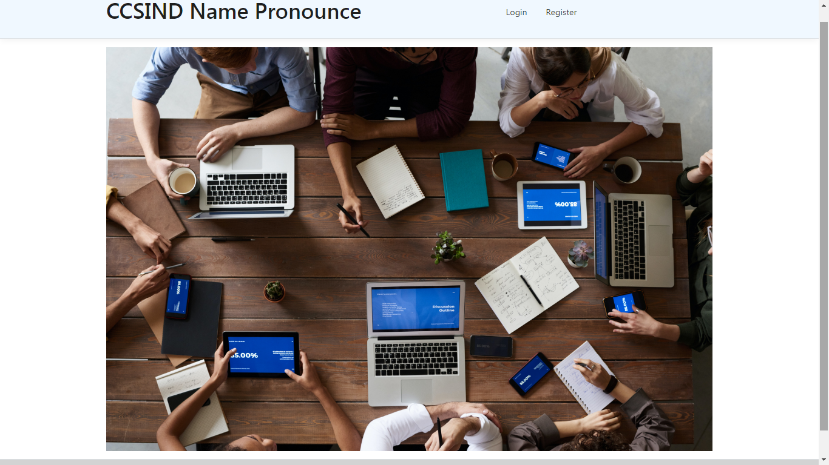
Home Page

Slide 3
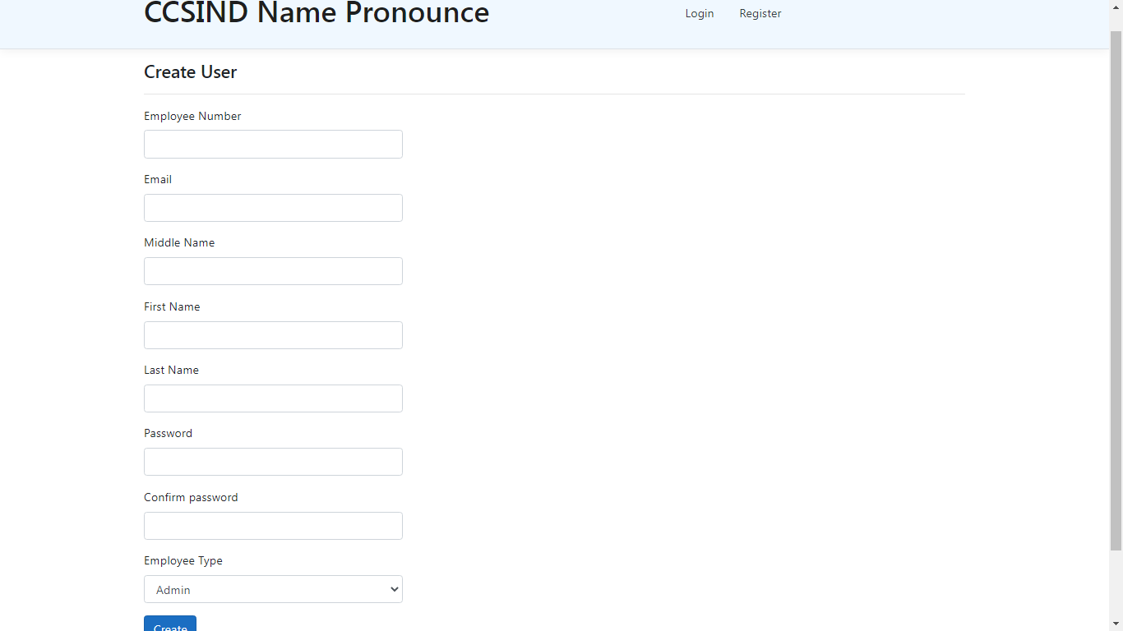
Register Page

Slide 4
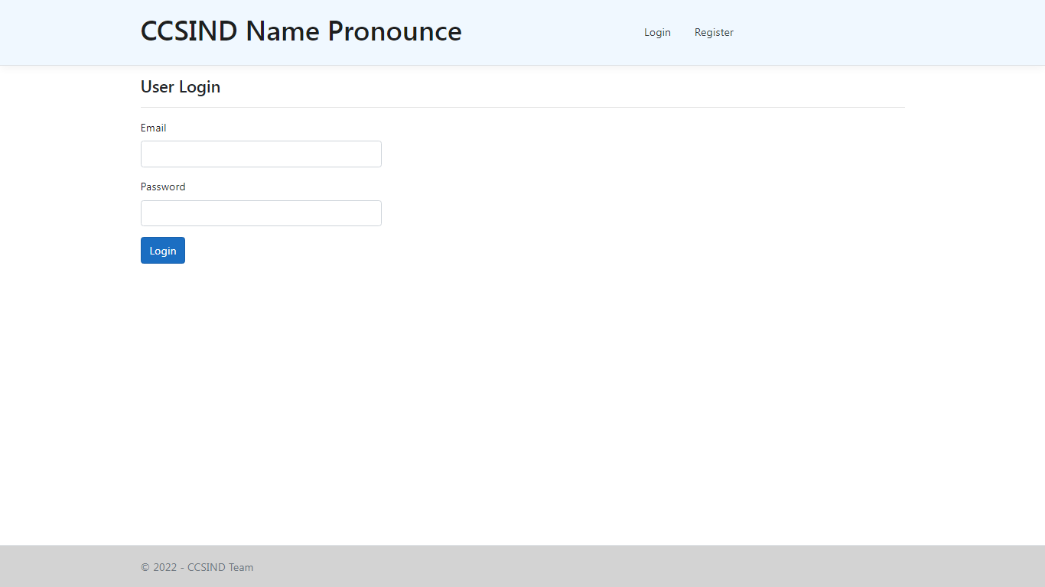
Login Page

Slide 5
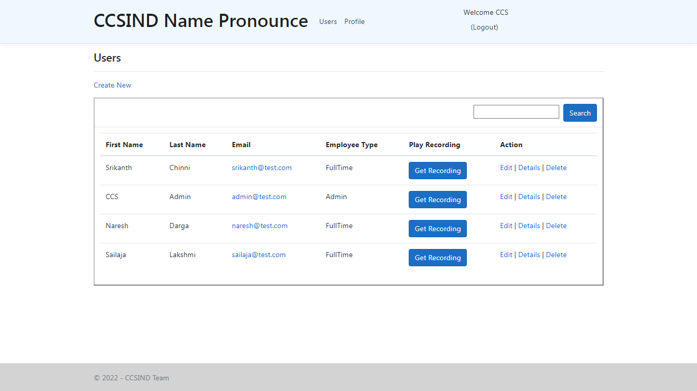
Admin – User List with Edit & Delete

Slide 6
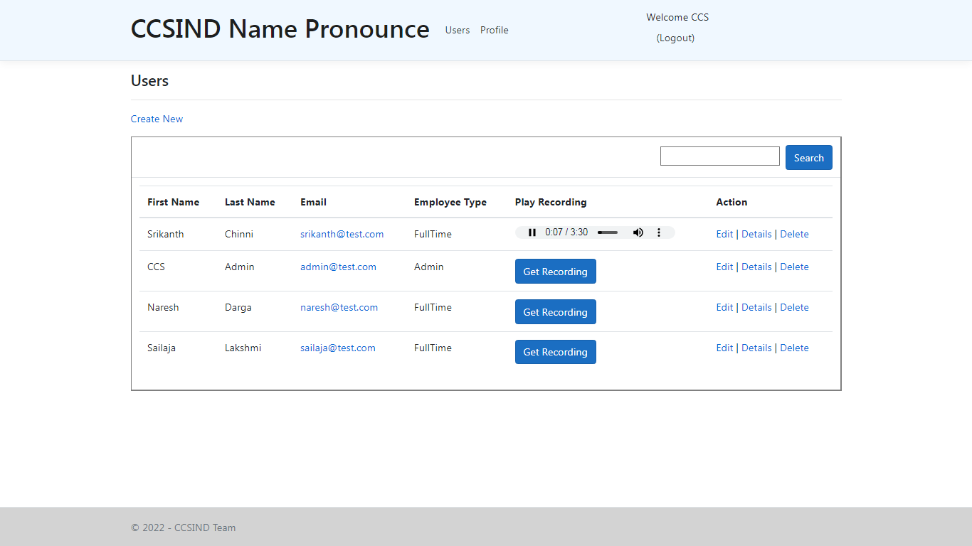
Admin – Play Recording of Users

Slide 7
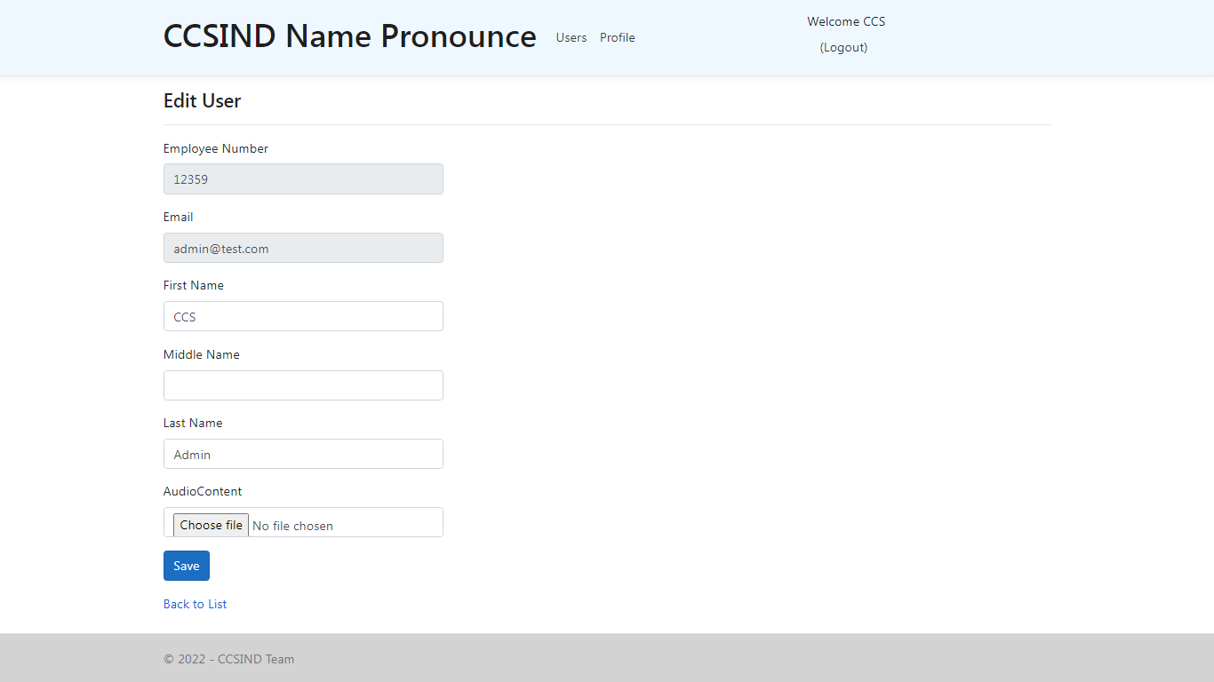
Profile Edit – Upload Recording

Slide 8
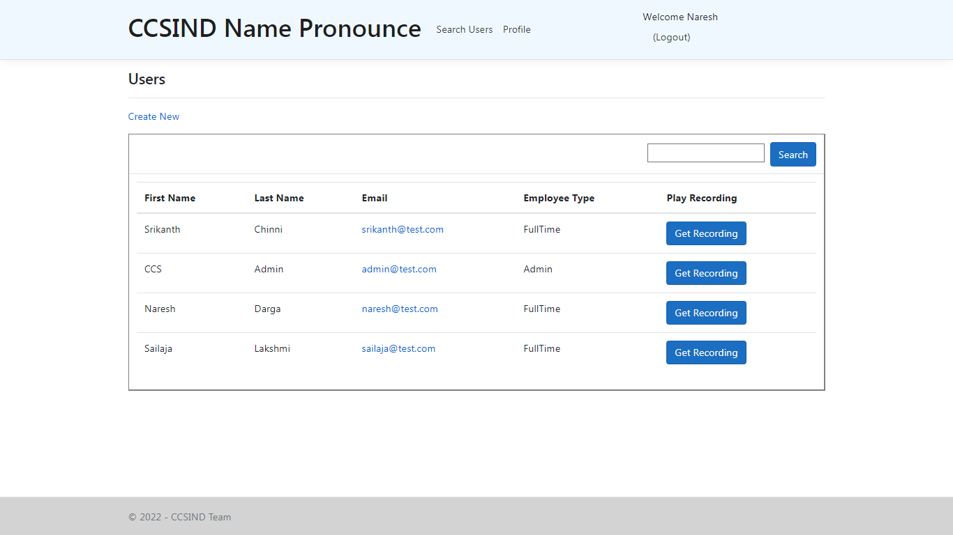
User Login – No Edit & Delete

Slide 9
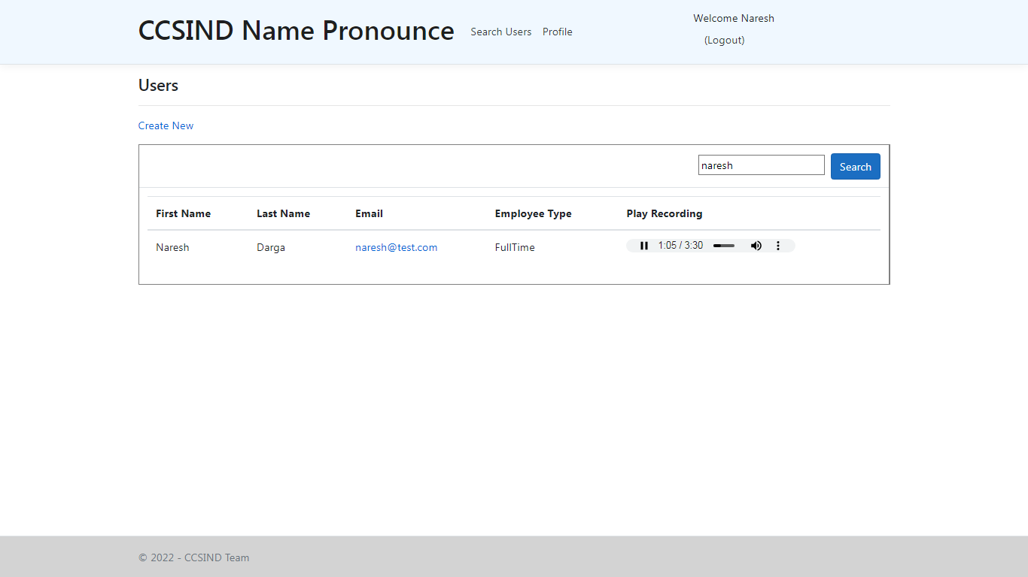
User Search with Play Recording

Slide 10
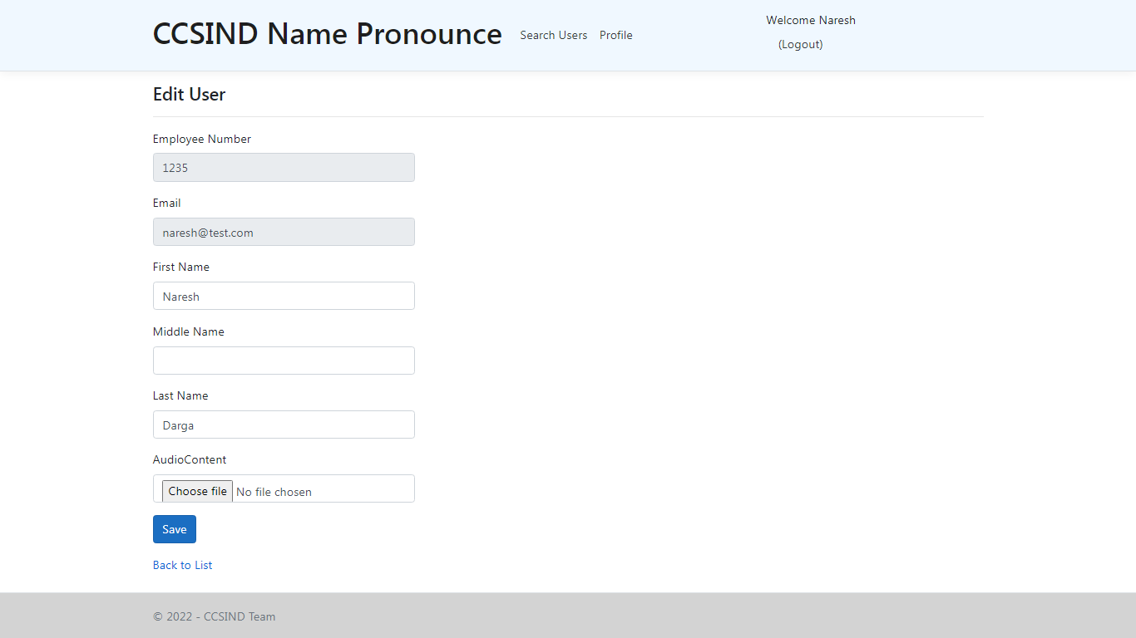
User Edit with Recording upload

Slide 11
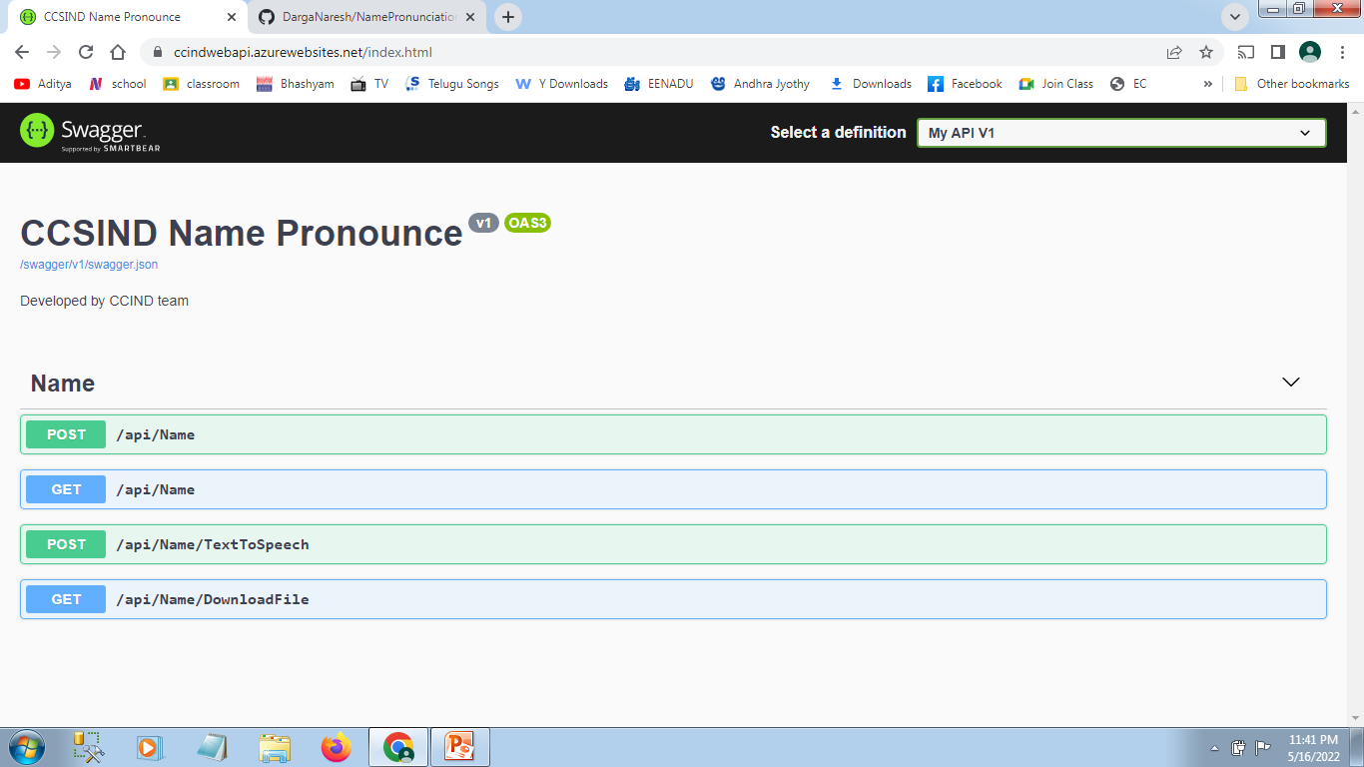
Web API
Name Service with Post is to upload audio and Get is to get the audio in byte stream

